Slide 1
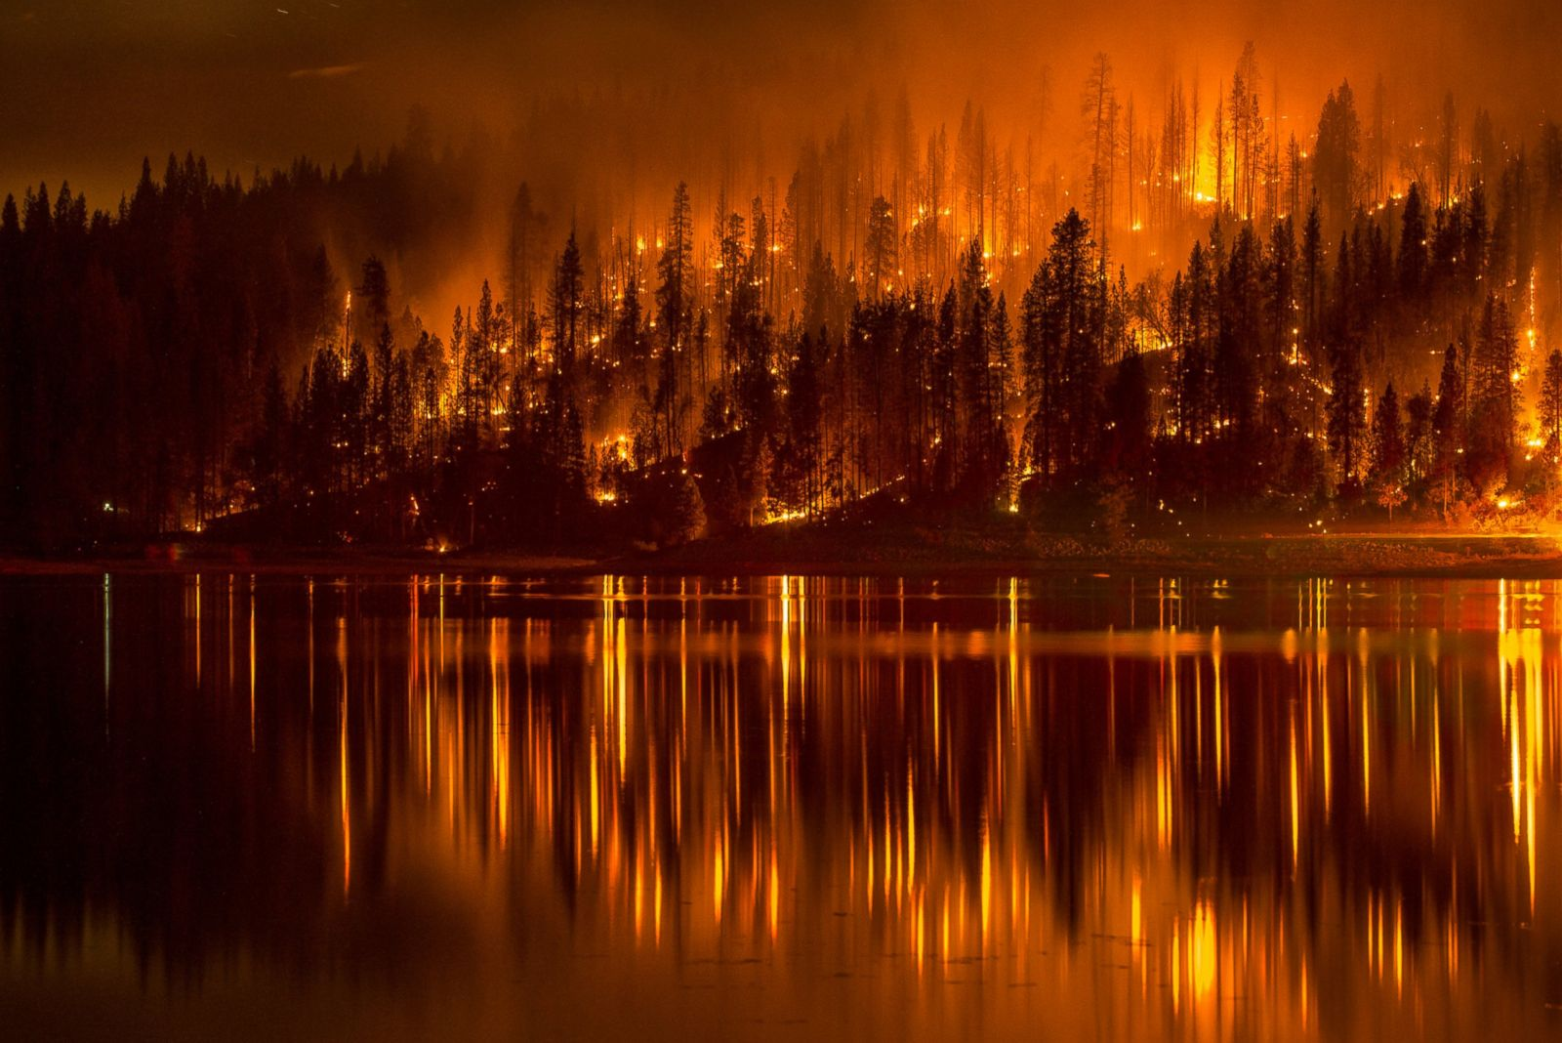
Wildfires in the United States from 1992-2015

Slide 2

Meet Our Team Members:
Ryan Johnson, Ann Ly, Raj Agrawal, Rob M

Slide 3
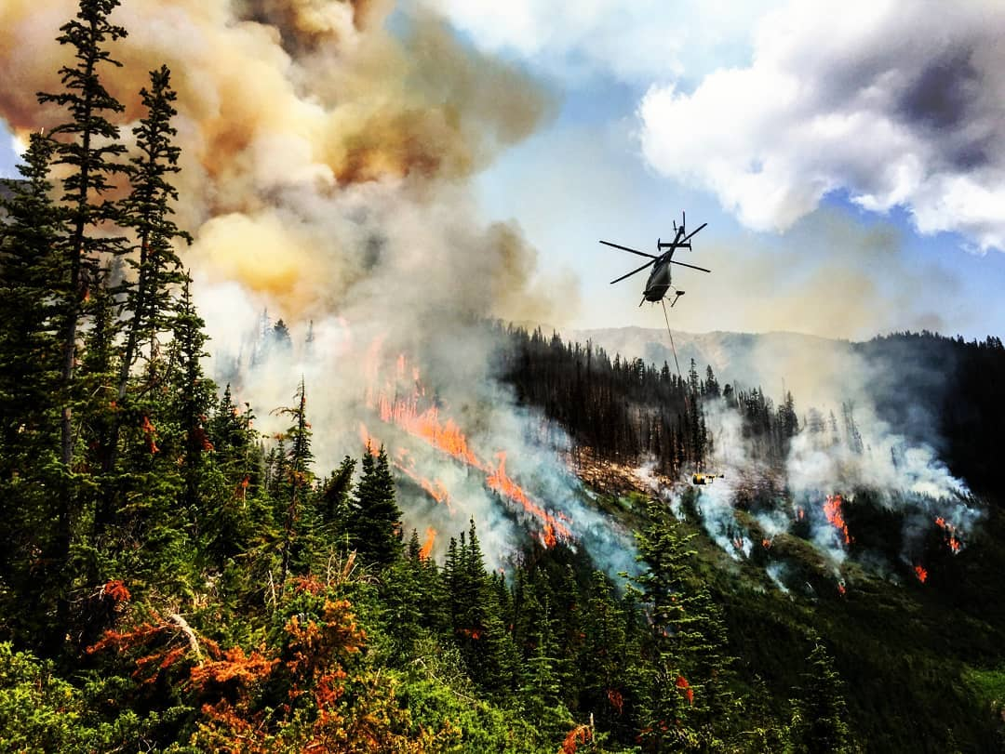
Agenda
Introduction
Data
Website and Analysis
Questions?

Slide 4
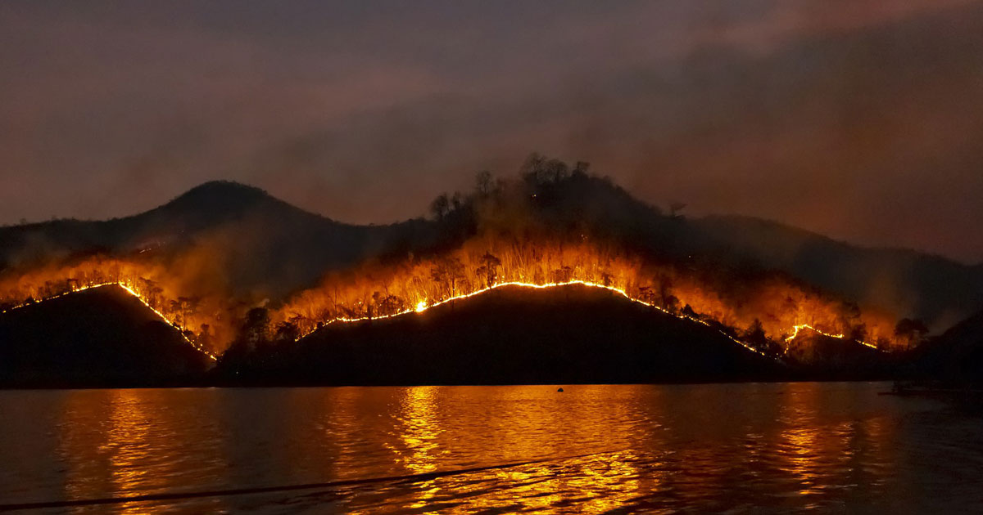
Introduction
“Wildfires are unplanned fires, including lightning-caused fires, unauthorized human-caused fires, and escaped fire from prescribed burn projects.” ---Wildfire Statistics (fas.org)
Wild Fires Damages Affecting:
-Ecological Resources -Wildlife habitats
    -Civilian lives lost -Firefighters lives lost
    -Structures destroyed -Etc….

Slide 5
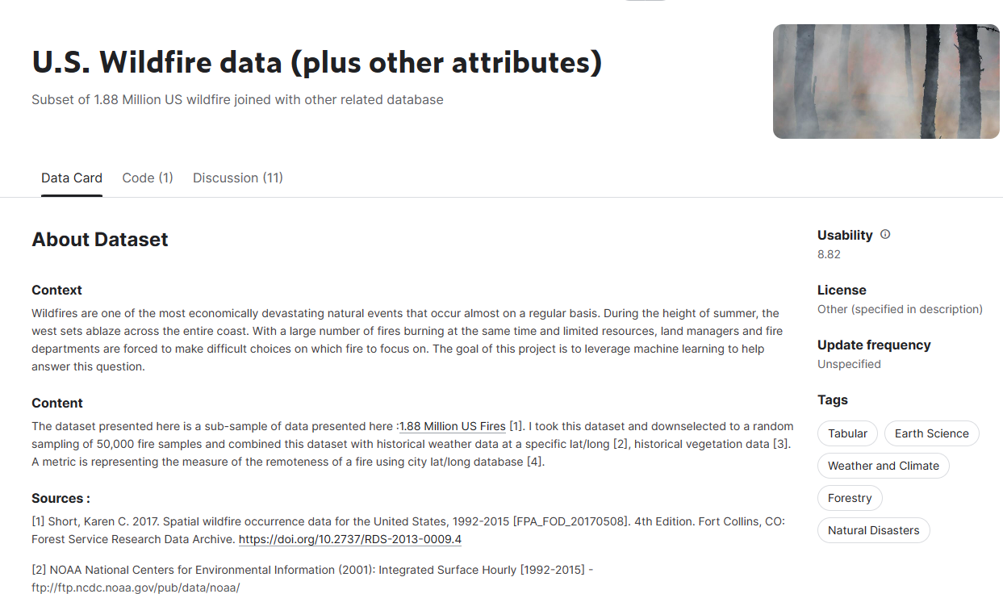
DATA
Our dataset is taken from Kaggle. The name of our data set is US Wildfire data (plus other attributes) - ﻿﻿﻿​​​U.S. Wildfire data (plus other attributes) | Kaggle
- It is a CSV file with the size of 18.9 MB and have 43 columns.
It contains a random selected of 50,000 fire samples from a huge dataset of 1.88 Million US Wild Fires.
This dataset contains data on wildfires in the US from 1992 to 2015
Our goal is to analyze the dataset to see if there are any patterns regarding the months and areas where wildfires are most likely to occurred.

Slide 6
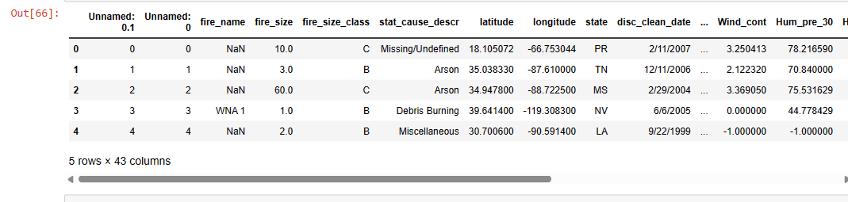

DATA CLEANING
- This dataset has a total of 43 columns. We used df.drop() to dropped off some unnecessary columns. Then we used df.notnull() to eliminate null items in the fire_name column. The data set after cleaned up contains a total of 28 columns. Finally, we convert the cleaned csv file to SQLite database.

Slide 7
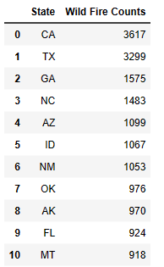
Data Analysis
- Based on the dataset, from 1992-2015, these are the top 10 states in the United States that have the highest number of wild fires. Notice how majority of the states listed here are from the Southern part of the US.

Slide 8
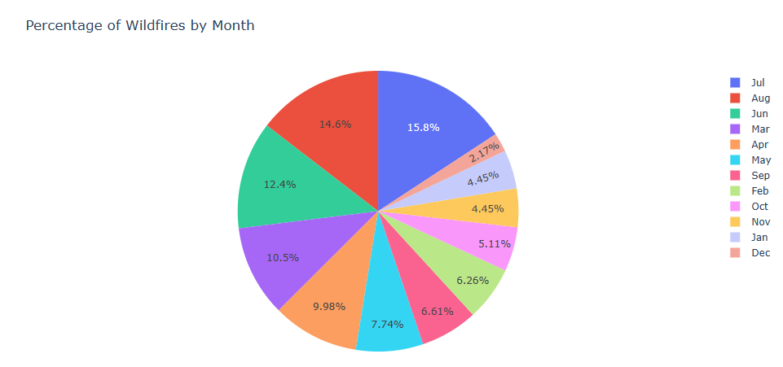
Data Analysis (cont.)
According to the data, July is the highest month in wildfire counts in the US followed by August and Jun. These are summer months. The previous chart showed top 10 states that has the most wild fires, and most of them located in the central/southern regions part of the US.

Slide 9
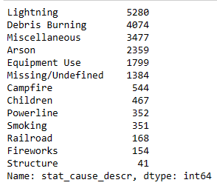
Causes of Wildfires in the US from 1992-2015

Slide 10
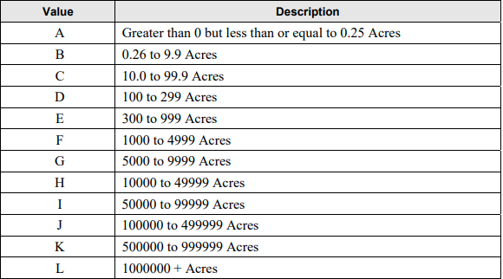
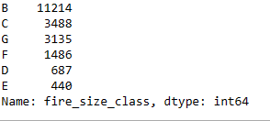
Data Analysis (cont.)
Class Acres Affected
B: .26-9.9 Acres (most)
C: 10-99.9 Acres
G: 5000-9999 Acres
F: 1000-4999 Acres
D: 100-299 Acres
E: 300-999 Acres(least)
Source: Fire Size Class Code https://www.nwcg.gov.sites/default/files/data-standards/pdf/values.pdf

Slide 11
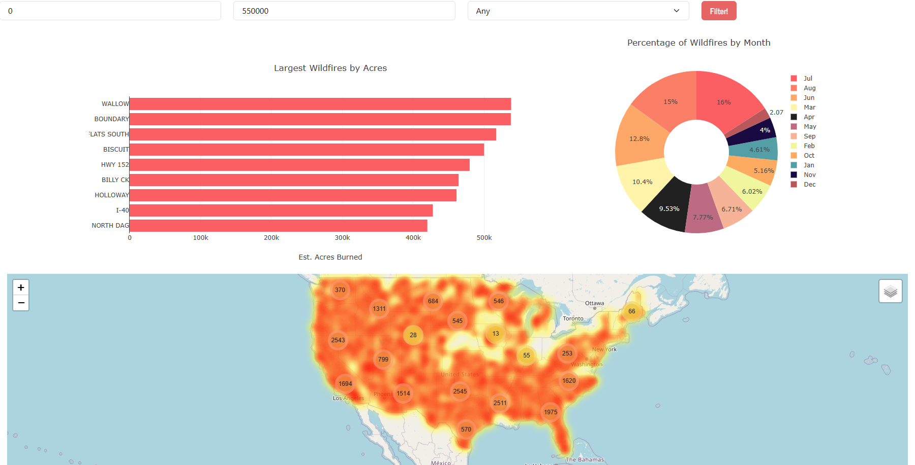
INTRODUCING OUR INTERACTIVE MAP INTERFACE
Using the data given, we created a map as well as a bar graph and a pie chart with the option of filtering the wildfire data at a given location when you pick a state. The bar chart represent the top 10 fires in that particular state identify by its name. The pie chart are calculated based on the wildfire events that occurred in each month in the span from 1992-2015.

Slide 12
Our Website URL:

Slide 13
References
﻿​​​﻿﻿﻿ - Wildfire Statistics
https://sgp.fas.org/misc/IF10244.pdf
-Fire Size Class Code
https://www.nwcg.gov.sites/default/files/data-standards/pdf/values.pdf

Slide 14
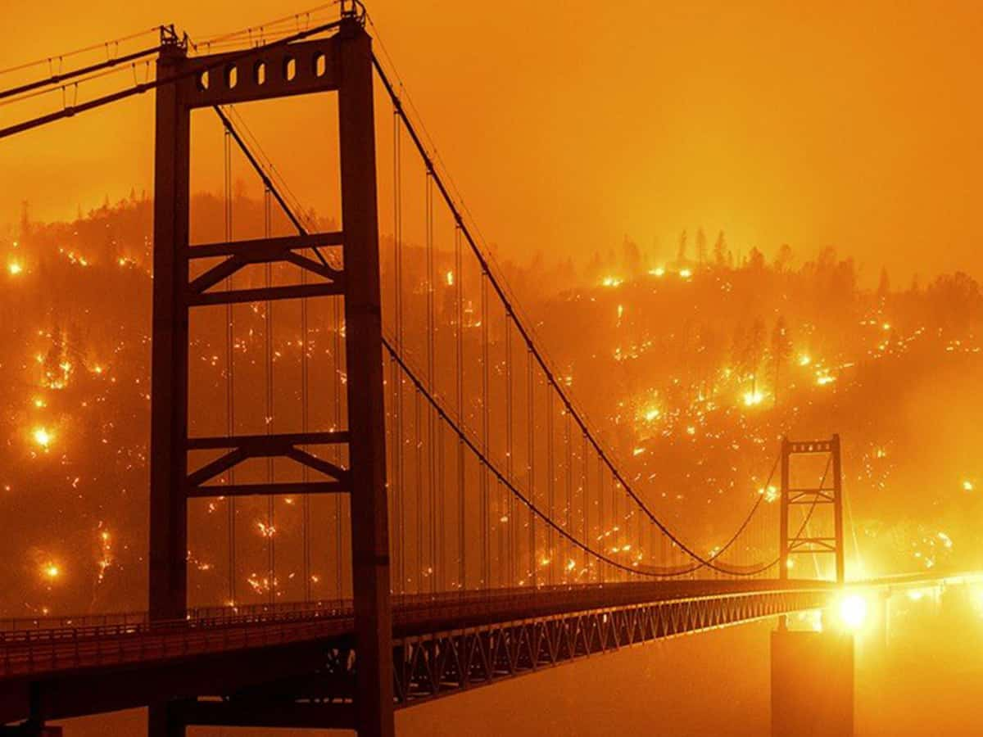
Questions?

